Slide 1


Online Vaccine Scheduler
Anil Erturk
Advisor: Dr. Ahreum Ju, Dr. Sam Chung
Week 10, Fall 2021
Computer Science
School of Technology & Computing (STC)

Slide 2
Agenda
Data Analysis
Findings
Conclusion
Demo
Future work
Key References
Q&A
Problem Statement
Motivation
Background
Related Work
Approach
Implementation
Data Collection
Notes:
Talk about what you are going to be talking about throughout the presentation in different pages.
(We are going to be talking about what we are trying to do. Then we will talk about why we are trying to do it. Etc.)
Problem Statement
Motivation
Background
Related Work
Approach
Design
Implementation
Data Collection
Data Analysis
Finding
Conclusion
Future Work
Key Reference
Q&A

Slide 3
Problem Statement
Can we allow unvaccinated people to socially distance more by giving them the necessary tools? (Cowling et al., 2020)
Getting vaccinated is a common denominator for unvaccinated people. So giving them remote tools for it will increase social distancing which is shown to decrease transmission.
Notes:
(Park et al., 2020): Potential Role of Social Distancing in Mitigating Spread of Coronavirus Disease, South Korea.

Slide 4
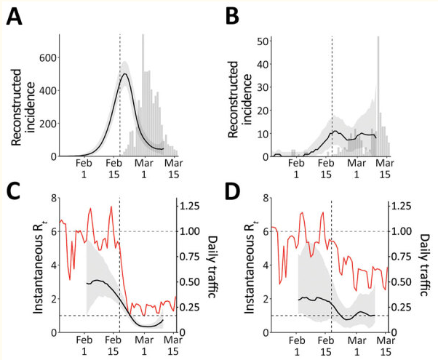
Motivation
Lowering the transmission of coronavirus. (Park et al., 2020)
Lowering the burden on the healthcare system.
Notes:
(Cowling et al., 2020): Public Health Measures to Slow Community Spread of Coronavirus Disease 2019.

Slide 5
Background
Factors: Age, gender/lifestyle, health risk, etc. (Cowling et al., 2020)
Public health measures based on these factors. (Park et al., 2020)
Social distancing is one of these measures.
Online vaccine scheduler is part of social distancing.
Notes:
Multiple factors affect the transmissibility of coronavirus.
Governments take these factors into account and come up with public health measures such as social distancing.
This project helps people socially distance more by giving them more remote capabilities.
(Park et al., 2020): Potential Role of Social Distancing in Mitigating Spread of Coronavirus Disease, South Korea.
(Price et al., 2021): The Effect of Social Distancing on the Early Spread of the Novel Coronavirus.
The number of infections decreased with respect to social distancing.
(Cowling et al., 2020): Public Health Measures to Slow Community Spread of Coronavirus Disease 2019
(Sallis et al., 2020): An international physical activity and public health research agenda to inform coronavirus disease-2019 policies and practices.

Slide 6
Related Work
Criteria | (Safeway, 2021) | (CVS, 2021) | (Rite Aid, 2021)
View/Edit/Delete appointment | No | No | No
Web application | Yes | Yes | Yes
Asks for symptoms | No | Yes | No
Multiple vaccines | Yes | Yes | Yes
Filter by vaccine | Yes | No | Yes
Filter by zip code | Yes | Yes | Yes
8 qualitative metrics
Notes:
Safeway (2021) Vaccinations.
https://www.safeway.com/vaccinations/home
CVS (2021) Vaccine.
https://www.cvs.com/vaccine/intake/store/covid-screener/covid-qns
Rite Aid (2021) Scheduler.
https://www.riteaid.com/pharmacy/scheduler

Slide 7
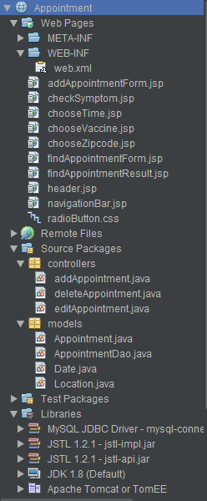
Approach
Web application vs. call center, MVC pattern. Modularization. SoC.
Important requirements: Scheduling, viewing, editing, and canceling of appointments.
Viewing, editing, and canceling of appointments are done using appointment ID.
Notes:
A web application is a better solution for this problem than a call center solution. And the
MVC pattern modularizes the web application.
Important requirements and user stories are scheduling, viewing, editing, and cancelling appointments.
Edit or cancel appointments through appointment ID, like plane tickets.

Slide 8
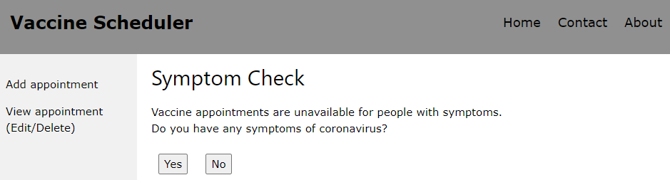
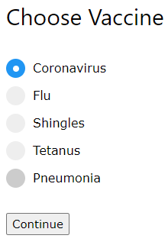
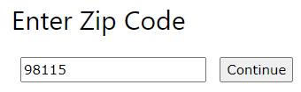
Implementation
Netbeans IDE
Java
Servlet, JSP, Spring
JSTL (JSP tag library)
MySQL + library
Apache Tomcat + library
Notes:
Java and Java web application technologies such as Servlet, JSP, and Spring.
MySQL database to store the vaccination location addresses, as well as the appointments
which include patient information.
I chose these technologies because they are capable and I am more experiences in them.

Slide 9
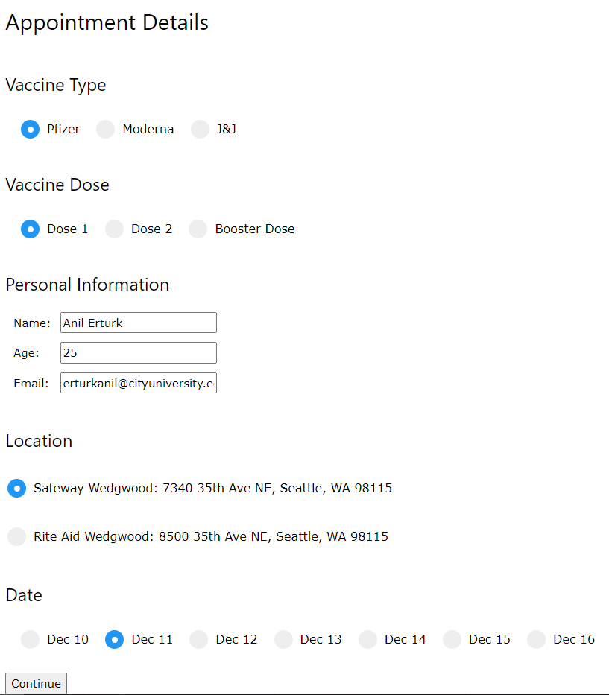
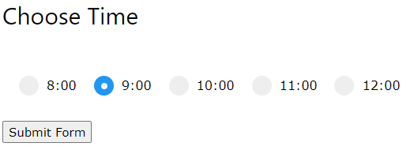
Data Collection
Data collection method is case study.
8 qualitative metrics.

Slide 10
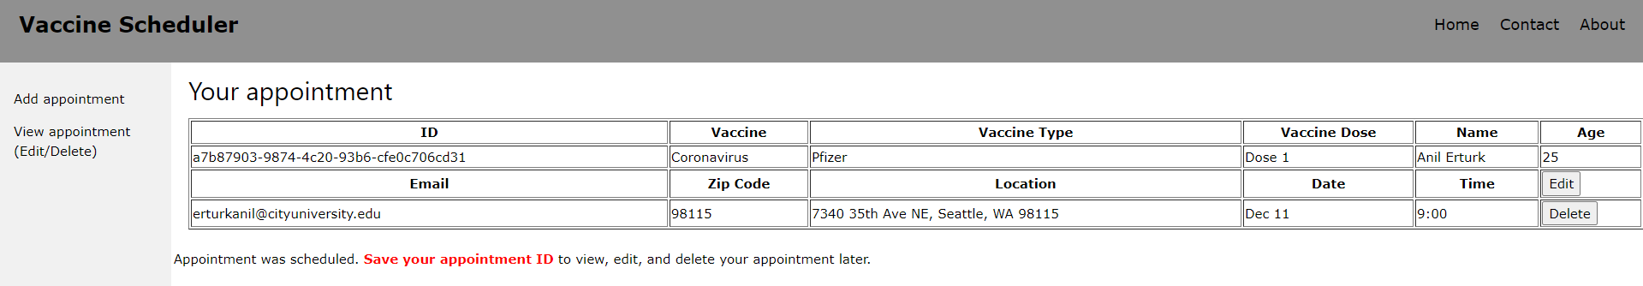
Data Collection
This solution has 7 of the features. View/Edit/Delete appointment. Web app. Ask symptoms. Multiple vaccines. Filter by zip code.
1 is left to future work. Adding location dataset and filtering them by selected vaccine.

Slide 11
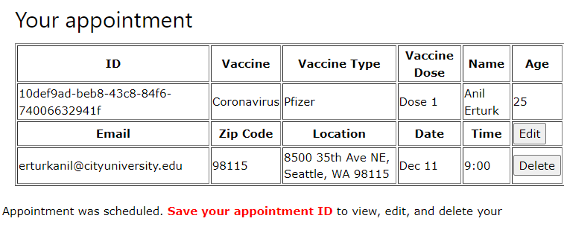
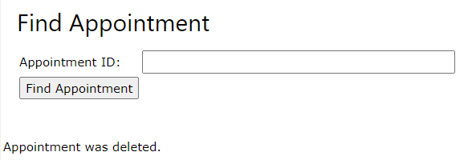
Data Analysis
Related work is missing the three features, view, edit, and delete appointment.
Location edited

Slide 12
Findings
Since the metrics are features for the website. More features allow for more social distancing.
The most important improvements are viewing, editing, deleting appointments.

Slide 13
Conclusion
The online vaccine scheduler with more remote features allows unvaccinated people to socially distance more.
Notes:
Can we allow people to socially distance by giving them the necessary tools? (Park et al., 2020)

Slide 14
Demo
Demo link: https://www.youtube.com/watch?v=7w1S09NEujA
Short link: https://bit.ly/3rQ19i6

Slide 15
Future Work
Find and add dataset of vaccination locations to the database.
Filter locations based on the vaccine selected.

Slide 16
Key references
Park, S. W., Sun, K., Viboud, C., Grenfell, B. T., & Dushoff, J. (2020). Potential Role of Social Distancing in Mitigating Spread of Coronavirus Disease, South Korea. Emerging Infectious Diseases, 26(11), 2697–2700.
Price, G., & Holm, E. (2021). The Effect of Social Distancing on the Early Spread of the Novel Coronavirus. Social Science Quarterly

Slide 17
Key References
Sallis, J. F., Adlakha, D., Oyeyemi, A., & Salvo, (2020). An international physical activity and public health research agenda to inform coronavirus disease-2019 policies and practices. The Journal of Sport and Health Sciences, 9(4), 328–334.
(Bogg et al., 2020)
(Cowling et al., 2020)

Slide 18


Q&A

